Slide 1
HTML Elements
Block and Inline Elements in HTML

Slide 2
Introduction
HTML elements are building blocks of web pages
They define layout and content
There are two main types
Block elements
Inline elements

Slide 3
Block Elements
Block elements take full width
Always start on new line
Used to create structure
Examples:
<div>
<p>
<h1>
<section>

Slide 4
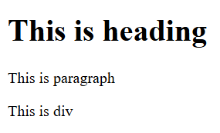
Example of Block Elements
<h1>This is heading</h1>
<p>This is paragraph</p>
<div>This is div</div>
Output:
Each element appears on new line

Slide 5
Most used block elements
Div
P
h1–h6
Section
Article
Form
Table
ul, ol, li

Slide 6
Inline Elements
Inline elements take only required width
Do not start on new line
Used inside block elements
Examples:
<span>
<a>
<strong>
<em>

Slide 7

Example of Inline Elements
<p>This is <span>inline</span> element</p>
<a href="#">This is link</a>
Output:
Elements appear in same line

Slide 8
Most used Inline elements
Span
A
Img
Input
Label
Strong
Em
br

Slide 9
Difference Between Block and Inline
Block Element | Inline Element
It takes Full width | It takes Only required width
Starts in New Line | Continue on Same line
Example: h1, div, p | Example: a, span

Slide 10
Conclusion
HTML elements are important
Block elements create structure
Inline elements add content inside
Both are used to design web pages

Slide 11
THANK YOU

